Slide 1
Motivating Your Employees

Slide 2

Agenda (30 minutes)
What is Engagement?
Why is it important?
Forms of Engagement
Examples of Engagement
Activity to generate/share ideas
Do’s and Don’ts of Engagement
What are other Universities doing?
Tools for managers to increase informal engagement
Notes:
Code 2342909

Slide 3

What is Engagement?
Employee engagement is an ongoing process in which (you) the Manager plays an integral role in the creation of experiences
through continual interaction with employees, which
impacts the employee's emotional commitment to
their work and organization.
Notes:
Code 2342909

Slide 4






Why Engagement?
Decreased absences/ turnover
Improved Health and Safety
Better Performance/Productivity
Developing of Brand Ambassadors
Contribute to Trent’s financial growth and success
Notes:
Code 2342909

Slide 5

Forms of Engagement
Informal:
  At the manager and team level where members of the institution can appreciate, recognize, and celebrate each other.
  More frequent, involving smaller number of individuals.
  Continually happening with every interaction you have with an employee.
Formal:
  Mainly organizationally driven,
  A top-down approach
  Seeking to encompass all members of the organization.
  Formal engagement is infrequent.
Notes:
Code 2342909

Slide 6

Forms of Engagement
Formal
Informal
Employee Engagement

Slide 7





Examples of Engagement
Appreciation and Recognition
Group Activities
Professional Development
Celebrations
Volunteer/Charity
Notes:
Code 2342909

Slide 8


Idea Sharing Activity
Notes:
https://www.menti.com/umnuqpvk9f
Code 2342909

Slide 9
Idea sharing Activity (10 Minutes)
We are going to split this group up in to teams of 5 using the Zoom breakout rooms.
Each group will brainstorm informal ideas on how you have engaged your teams in the past or ideas on how you can engage your teams in the future at the departmental/team level.
Choose one person in each group to email your groups list of ideas to humanresources@trentu.ca.
The list of ideas generated by all groups will be emailed to all managers as part of the engagement tools
Notes:
https://www.menti.com/umnuqpvk9f
Code 2342909

Slide 10

Do’s of Engagement
Empower employees
Offer opportunities for development/growth
Be transparent and authentic
Listen
Be fair and just
Set some rules for your personal guidelines of engagement
Learn more
Incorporate some fun at work
Lead by example
Notes:
Code 2342909

Slide 11


Don’ts of Engagement
Fill their time with undervalued tasks
Ignore your employees
Forget to reward performance
Prevent socialization
Rely on organizational engagement activities to keep your employees engaged
Notes:
Code 2342909

Slide 12


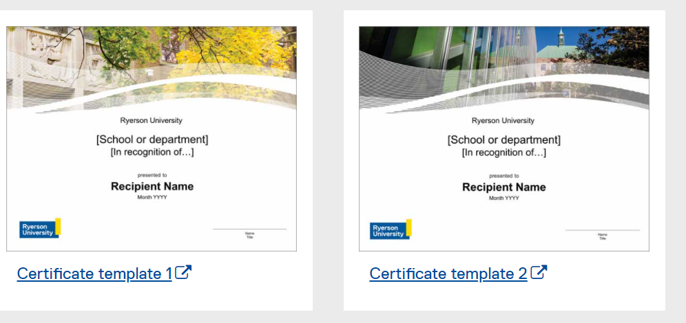
What are other Universities doing?
Ryerson
Windsor
Notes:
Code 2342909

Slide 13

What are other Universities doing?
McMasters
Notes:
Code 2342909

Slide 14
What are other Universities doing?
Ryerson
  Formal: Service Milestones, Employee Awards;
  Informal: Ecards, Paper cards, Informal Certificates, Ryerson Eats Voucher cards, Gift Cards (Rules to be followed)
McMaster
  Formal: Service Awards, Quarter Century Club, President’s awards for outstanding Service, Peer Recognition Program, Volunteer opportunities on different committees, children parties, Healthy Workplace programs, Inspiring from Within Employee Development Conference;
  Informal: Encourage informal and day to day recognition, provided managers with ideas on how to recognize employees
Windsor
  Formal: Years of Service Milestone Award, Employment Recognition Awards;
  Informal: “Making a Difference Every Day” initiative
Ontario Tech
  Formal: 10-year service award, Awards of excellence;
  Informal: PRAISE program-Peers Recognizing Achievements in Standout Employee )
Notes:
Code 2342909

Slide 15

Tools for Trent Managers
Get to Know Your Employees Better
Manager Self-assessment Tool
Ideas for Engagement
Conversation starters to promote informal engagement
Additional Training (i.e. LinkedIn Learning, Lifework's EAP for Managers)
Notes:
Code 2342909

Slide 16

Anonymous Poll: Do you think having more information and tools available to you on this topic will be beneficial to you as a manager?
YES – I would love to have more information and tools.
NO – I think this presentation covered enough information and do not feel I need anything more on this topic.

Slide 17
Thank you!
For more information or questions, please email humanresources@trentu.ca

